Slide 1
Help Wanted Online
A real-time measure of job postings
December 2021
Office of Research
Connecticut Department of Labor
Connecticut Department of Labor – Research Office
200 Folly Brook Blvd.
Wethersfield, CT 06109
Help Wanted Online

Slide 2
What is HWOL?
The Conference Board Help Wanted Online® Data Series (HWOL) measures the number of new, first-time Online job postings and jobs reposted from the previous month for over 50,000 Internet job boards, corporate boards and smaller job sites that serve niche markets and smaller geographic areas.
Connecticut Department of Labor – Research Office
200 Folly Brook Blvd.
Wethersfield, CT 06109
Help Wanted Online

Slide 3
Upcoming Release Dates
Monthly Report:
Friday, January 14th, 2021
Weekly New Ads Report:
Updated every Friday
Connecticut Department of Labor – Research Office
200 Folly Brook Blvd.
Wethersfield, CT 06109
Help Wanted Online

Slide 4
Statewide Weekly New Job Ads
Weekly New job postings were 8,346 during the week ending 12/04/21.
Connecticut Department of Labor – Research Office
200 Folly Brook Blvd.
Wethersfield, CT 06109
Help Wanted Online

Slide 5
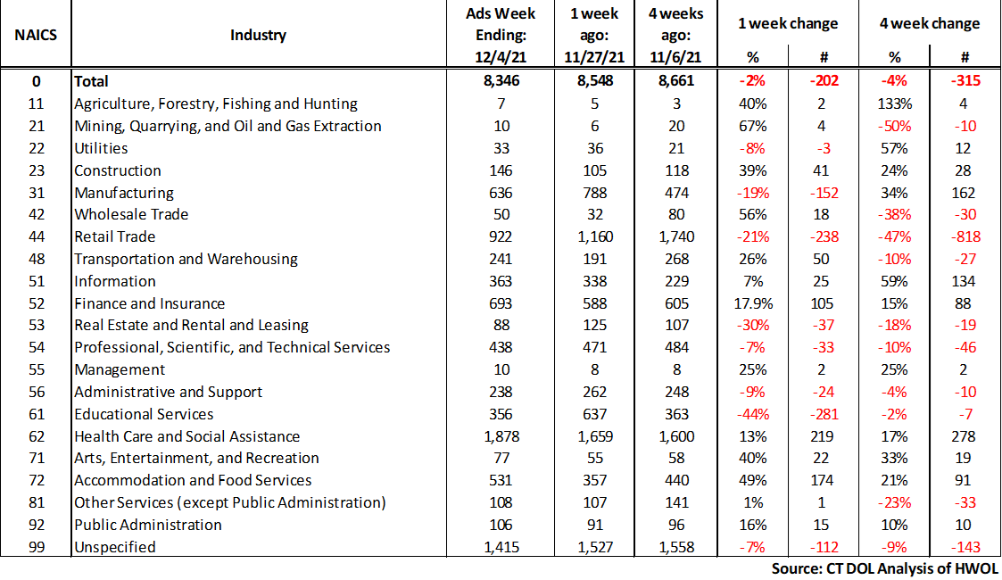
HWOL New Weekly Industry Job Ads – CT Statewide
Connecticut Department of Labor – Research Office
200 Folly Brook Blvd.
Wethersfield, CT 06109
Help Wanted Online

Slide 6
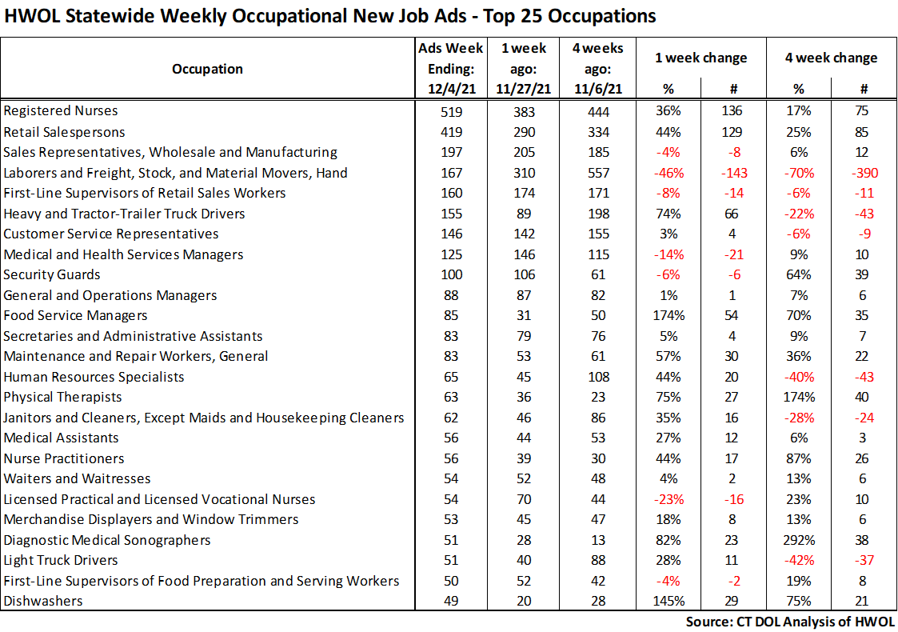
Connecticut Department of Labor – Research Office
200 Folly Brook Blvd.
Wethersfield, CT 06109
Help Wanted Online

Slide 7
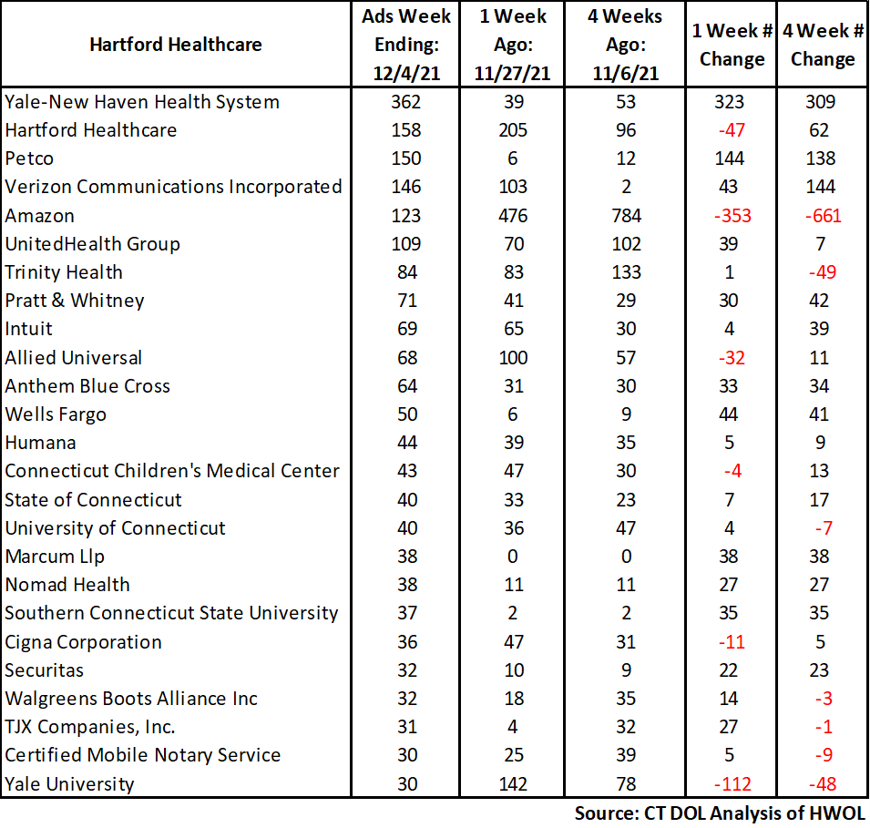
Employers with the Most New Job Postings
Connecticut Department of Labor – Research Office
200 Folly Brook Blvd.
Wethersfield, CT 06109
Help Wanted Online

Slide 8
Monthly HWOL Information
The following pages contain HWOL monthly data for November 2021.
Monthly and weekly job ad information can be found here:
https://www1.ctdol.state.ct.us/lmi/HWOL.asp
Connecticut Department of Labor – Research Office
200 Folly Brook Blvd.
Wethersfield, CT 06109
Help Wanted Online

Slide 9
Statewide Highlights
- Total postings in Connecticut was 105,896 in November 2021.
-Industry sectors with the most job postings were Health Care and Social Assistance (22,240 postings), Retail Trade (15,238 postings), Finance and Insurance (8,286 posting), and Manufacturing (6,717 postings).
-Occupations with the most postings were Registered Nurses (6,091 postings), Retail Salespersons (3,838 postings), Laborers, Freight, & Material Movers (3,576 postings), Wholesale & Manufacturing Sales Representatives (2,525 postings), and Heavy & Tractor-Trailer Truck Drivers (2,362 postings).
Connecticut Department of Labor – Research Office
200 Folly Brook Blvd.
Wethersfield, CT 06109
Help Wanted Online

Slide 10
Connecticut Job Ads by Educational Requirements
Connecticut Department of Labor – Research Office
200 Folly Brook Blvd.
Wethersfield, CT 06109
Help Wanted Online

Slide 11
Top Certifications in Connecticut Job Ads
Connecticut Department of Labor – Research Office
200 Folly Brook Blvd.
Wethersfield, CT 06109
Help Wanted Online

Slide 12
Top Skills in Connecticut Job Ads
Connecticut Department of Labor – Research Office
200 Folly Brook Blvd.
Wethersfield, CT 06109
Help Wanted Online

Slide 13
Top Skills by Industry in Connecticut Job Ads
Connecticut Department of Labor – Research Office
200 Folly Brook Blvd.
Wethersfield, CT 06109
Help Wanted Online

Slide 14
Top Skills by Industry in Connecticut Job Ads (Continued)
Connecticut Department of Labor – Research Office
200 Folly Brook Blvd.
Wethersfield, CT 06109
Help Wanted Online

Slide 15
Connecticut Department of Labor – Research Office
200 Folly Brook Blvd.
Wethersfield, CT 06109
Help Wanted Online

Slide 16
Connecticut Employers with the Most Job Ads
Connecticut Department of Labor – Research Office
200 Folly Brook Blvd.
Wethersfield, CT 06109
Help Wanted Online

Slide 17
Connecticut Occupations with the Most Job Ads
Connecticut Department of Labor – Research Office
200 Folly Brook Blvd.
Wethersfield, CT 06109
Help Wanted Online

Slide 18
Connecticut Job Ads by Industry and Major Occupational Group
Connecticut Department of Labor – Research Office
200 Folly Brook Blvd.
Wethersfield, CT 06109
Help Wanted Online

Slide 19
Workforce Area Data
Workforce Area Highlights
Job Ads by Industry
Job Ads by Location
Employers With The Most Job Ads
Occupations With The Most Job Ads
Connecticut Department of Labor – Research Office
200 Folly Brook Blvd.
Wethersfield, CT 06109
Help Wanted Online

Slide 20
Workforce Area Highlights
Connecticut Department of Labor – Research Office
200 Folly Brook Blvd.
Wethersfield, CT 06109
Help Wanted Online

Slide 21
Connecticut Department of Labor – Research Office
200 Folly Brook Blvd.
Wethersfield, CT 06109
Help Wanted Online

Slide 22
Eastern Workforce Job Ads by Location
Connecticut Department of Labor – Research Office
200 Folly Brook Blvd.
Wethersfield, CT 06109
Help Wanted Online

Slide 23
Eastern Workforce Employers
with the Most Job Ads
University of Connecticut
Day Kimball Healthcare
Amazon
Pfizer
Mohegan Sun, Inc
Windham Hospital
Generations Family Health Center
Trinity Health
Petco
Bob's Discount Furniture
Walgreens Boots Alliance Inc
BJ's Wholesale Club, Inc.
Thames Valley Council For Community Action
The Home Depot Incorporated
Groton Public Schools
Mashantucket Pequot Gaming
Reliance Health Group
Masonicare Corporation
Yale-New Haven Health System
General Dynamics
William W. Backus Hospital
Windham Community Hospital
Mohegan Sun
Norwich Public Schools
Fm Global
Lowe's Companies, Inc
Natchaug Hospital Incorporated
State of Connecticut
Compass Group North America
United Services Incorporated
Sonalysts Incorporated
US Foods
Asplundh Tree Expert Company
Staples
Nordson Corporation
CVS Health
United Parcel Service Incorporated
Connecticut Department of Labor – Research Office
200 Folly Brook Blvd.
Wethersfield, CT 06109
Help Wanted Online

Slide 24
Eastern Workforce Occupations
with the Most Job Ads
Connecticut Department of Labor – Research Office
200 Folly Brook Blvd.
Wethersfield, CT 06109
Help Wanted Online

Slide 25
Connecticut Department of Labor – Research Office
200 Folly Brook Blvd.
Wethersfield, CT 06109
Help Wanted Online
25

Slide 26
North Central WDA Job Ads by Location
Connecticut Department of Labor – Research Office
200 Folly Brook Blvd.
Wethersfield, CT 06109
Help Wanted Online

Slide 27
North Central WDA Employers
with the Most Job Ads
UnitedHealth Group
Cigna Corporation
Deloitte
ECHN
State of Connecticut
Travelers
Aya Healthcare
Accenture
Disney
United Parcel Service Incorporated
The Home Depot Incorporated
Advantage Sales & Marketing
Hartford Public Schools
Department Administrative Services
Walgreens Boots Alliance Inc
Boston Market
Guidehouse
Verizon Communications Incorporated
Carvana LLC
Amazon
Hartford Healthcare
Raytheon
Trinity Health
Allied Universal
Connecticut Children's Medical Center
CVS Health
Travelers Hartford
The Hartford Financial Group
Wheeler Clinic
Stanley Black & Decker
Eastern Connecticut Health Network
Nelnet
FedEx
Pearson
Laboratory Corporation of America
Ukg Ultimate Kronos Group
Petco
Sysco Corporation
Connecticut Department of Labor – Research Office
200 Folly Brook Blvd.
Wethersfield, CT 06109
Help Wanted Online

Slide 28
North Central WDA Occupations
with the Most Job Ads
Connecticut Department of Labor – Research Office
200 Folly Brook Blvd.
Wethersfield, CT 06109
Help Wanted Online

Slide 29
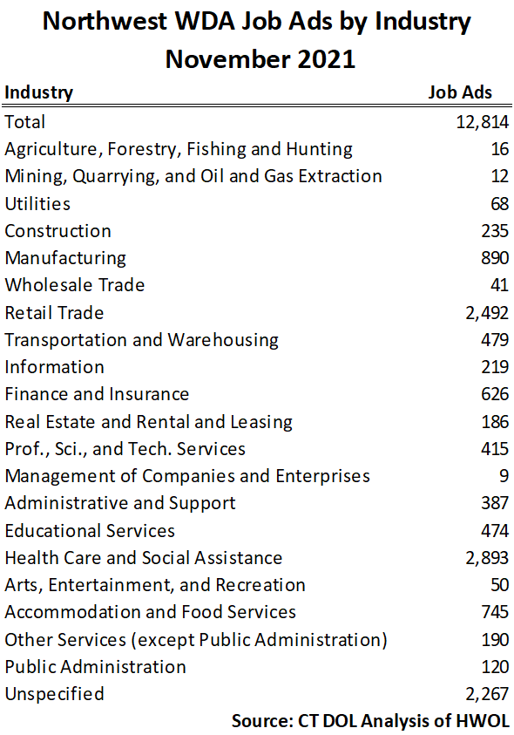
Connecticut Department of Labor – Research Office
200 Folly Brook Blvd.
Wethersfield, CT 06109
Help Wanted Online

Slide 30
Northwest WDA Job Ads by Location
Connecticut Department of Labor – Research Office
200 Folly Brook Blvd.
Wethersfield, CT 06109
Help Wanted Online

Slide 31
Northwest WDA Employers
with the Most Job Ads
Amazon
Boehringer Ingelheim
Waterbury Hospital
Aya Healthcare
The Home Depot Incorporated
Monterey Institute Of International Studies
Post University
Intuit
BJ's Wholesale Club, Inc.
Benchmark Senior Living
Advantage Sales & Marketing
CVS Health
Fuelcell Energy Inc
Naugatuck Public Schools
Verizon Communications Incorporated
Lowe's Companies, Inc
Seasons Hospice & Palliative Care
Trugreen
Nuvance Health
Trinity Health
United Parcel Service Incorporated
UnitedHealth Group
Petco
Whole Foods Market, Inc.
State of Connecticut
Carvana LLC
AutoZone Auto Parts
Compass Group North America
Walgreens Boots Alliance Inc
Charlotte Hungerford Hospital
State Farm Insurance Companies
Realogy Franchise Group LLC
Stop Shop Supermarket
Macy's
Department Administrative Services
YMCA
Wells Fargo
Connecticut Department of Labor – Research Office
200 Folly Brook Blvd.
Wethersfield, CT 06109
Help Wanted Online

Slide 32
Northwest WDA Occupations
with the Most Job Ads
Connecticut Department of Labor – Research Office
200 Folly Brook Blvd.
Wethersfield, CT 06109
Help Wanted Online

Slide 33
Connecticut Department of Labor – Research Office
200 Folly Brook Blvd.
Wethersfield, CT 06109
Help Wanted Online

Slide 34
South Central WDA Job Ads by Location
Connecticut Department of Labor – Research Office
200 Folly Brook Blvd.
Wethersfield, CT 06109
Help Wanted Online

Slide 35
South Central WDA Employers
with the Most Job Ads
Yale University
Medtronic
Advantage Sales & Marketing
St Vincent’s Medical Center
Allied Universal
The Home Depot Incorporated
Avangrid
Walgreens Boots Alliance Inc
AutoZone Auto Parts
Lowe's Companies, Inc
Quest Diagnostics Incorporated
Honeywell
Southern Connecticut State University
Alexion Pharmaceuticals
Department of Veterans Affairs
University of New Haven
Raytheon
Benchmark Senior Living
Michaels Arts and Crafts
Amazon
Yale-New Haven Health System
Anthem Blue Cross
United Parcel Service Incorporated
Community Health Center, Inc.
Petco
UnitedHealth Group
State of Connecticut
Aya Healthcare
Middlesex Health System Incorporated
Verizon Communications Incorporated
Gaylord Specialty Healthcare
Genesis Healthcare Corporation
O'Reilly Automotive Inc
FedEx
A R Mazzotta Employment
Taco Bell
Seasons Hospice & Palliative Care
Quinnipiac University
Connecticut Department of Labor – Research Office
200 Folly Brook Blvd.
Wethersfield, CT 06109
Help Wanted Online

Slide 36
South Central WDA Occupations
with the Most Job Ads
Connecticut Department of Labor – Research Office
200 Folly Brook Blvd.
Wethersfield, CT 06109
Help Wanted Online

Slide 37
Connecticut Department of Labor – Research Office
200 Folly Brook Blvd.
Wethersfield, CT 06109
Help Wanted Online

Slide 38
Southwest WDA Job Ads by Location
Connecticut Department of Labor – Research Office
200 Folly Brook Blvd.
Wethersfield, CT 06109
Help Wanted Online

Slide 39
Southwest WDA Employers
with the Most Job Ads
Amazon
Deloitte
Charter Communications
Sema4
Allied Universal
Vmware Incorporated
Lockheed Martin Corporation
Compass Group North America
Asml United States Incorporated
St. Vincent's Health Service
United Parcel Service Incorporated
Advantage Sales & Marketing
The Home Depot Incorporated
KPMG
Sacred Heart University
UnitedHealth Group
World Wrestling Entertainment
Boston Market
Humana
Yale-New Haven Health System
Aya Healthcare
Stamford Hospital
Whole Foods Market, Inc.
Norwalk Public School District
PricewaterhouseCoopers
Gartner Incorporated
Synchrony
Capital One
Griffin Health
Petco
Intuit
Stamford Public Schools
Norwalk Public Schools
Rolls Royce Plc
Benchmark Senior Living
CVS Health
Connecticut Department of Labor – Research Office
200 Folly Brook Blvd.
Wethersfield, CT 06109
Help Wanted Online

Slide 40
Southwest WDA Occupations
with the Most Job Ads
Connecticut Department of Labor – Research Office
200 Folly Brook Blvd.
Wethersfield, CT 06109
Help Wanted Online

Slide 41
All advertisement data used in this publication is from the Conference Board’s Help Wanted Online data series.
For more information or data requests, contact
Matthew Krzyzek in the Office of Research at the Department of Labor.
Matthew.Krzyzek@ct.gov
For more Connecticut Labor Market Information visit:
www.ctdol.state.ct.us/lmi
https://www.facebook.com/ctlmi
Twitter: @DOL_Research
Connecticut Department of Labor – Research Office
200 Folly Brook Blvd.
Wethersfield, CT 06109
Help Wanted Online

